Slide 1

AJAX-1
SHARMA COMPUTER ACADEMY

Slide 2
What is AJAX ?
AJAX stands for Asynchronous Java script And Xml.
AJAX is not a new language , rather it is a new style of programming made popular by Google in 2007 and today it is the backbone of every dynamic web application.

Slide 3
Need Of AJAX ?
Before AJAX , the only way a client side web page could communicate with a server was via html form using GET/POST request.
Java Script had no way of communicating with the server.

Slide 4
Need Of AJAX ?
But , sometimes on slow networks FORM HANDLING could take time .
Moreover most of the time the new page has 90% elements same as the previous page only 10% of data gets changed.

Slide 5
Solution
Solution is Ajax
“Ajax allows Java Script code to communicate directly with the server”.

Slide 6
HOW ?
This is done using a special Java Script object called XMLHttpRequest.
With this object, our Java Script code can get information from the server without having to load a new page!

Slide 7

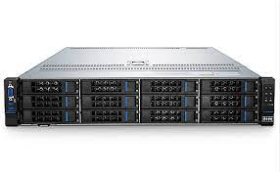
WORKING OF AJAX
1. An event occurs on a web page e.g-a button is clicked
3. Process the HTTP request
and creates a response
2. An HTTP request is sent to
server using XMLHttpRequest object
Google
Network
Server
Browser
4. Send response
back to the browser
5. Process the returned data using JavaScript and updates the page content

Slide 8
Step of AJAX Programming
Following are the steps involved in AJAX :
1. Create Object for Ajax Request.
2. Specify a Handler.
3. Send the request.
4. Retrieve the data.

Slide 9
Step 1 : Creating Object
The first step in AJAX based communication is to create an object of type XMLHttpRequest.
It is a built in object supported by every browser which has some very important properties/methods for generating Ajax request and receiving response.

Slide 10
Code
<script >
let ajaxreq=new XMLHttpRequest();
.
.
.
</script>

Slide 11
Step 2 : Specify Handler
When we use AJAX we can’t be sure when the response will come back .
So before we generate the request we must first specify a function to be called when the response comes back from the server.
This function is called “RESPONSE HANDLER”.

Slide 12
Step 2 : Specify Handler
Tasks of RESPONSE HANDLER :
A. Receive the information sent by server.
B. Extract the data.
C. Display the result at appropriate place on the web page.

Slide 13
Step 2 : Specify Handler
Syntax :
ajaxreq.onreadystatechange=<func name>;
The onreadystatechange is the property of the AJAX object which receives a function name as it’s value .
Now , every time the readyState property of the AJAX object changes then the function gets executed.

Slide 14
What Is the readyState property ?
The process of communicating with the server begins with sending of the request and finishes when the response comes back .
In between there are many stages involved and these stages are represented using the readyState property

Slide 15
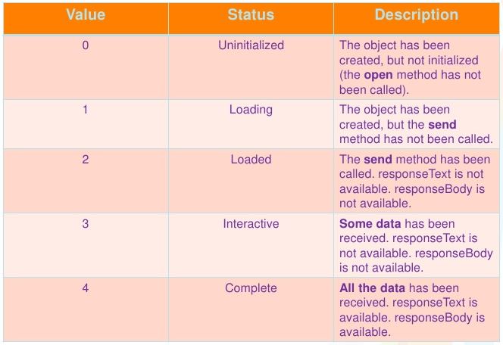
The readyState values

Slide 16
The readyState values
Every time the readyState changes , the function indicated by the onreadystatechange property gets called.
There are five values of readyState, so the function will be called four times .
But we are interested in the completed state because the data is only available after the state is 4

Slide 17
The Handler Function
function<function name>(){
if (ajaxreq.readyState===4){
// do something with the data
}
}

Slide 18
Step 3: Send The information
After we have specified handler we can send request to the server and this involves 2 steps:
A. Opening the connection .
B. Sending the request.

Slide 19
Step 3 A: Opening The Connection
Before sending the request we need to establish a connection to the server which is done by calling the method open( ) of the XMLHttpRequest object.
It has the following prototype:
open(method , url , isasynchronous)

Slide 20
Step 3 A: Opening The Connection
method : The type of request: GET or POST
url : URL of the page to request.
isasynchronous: a boolean value indicating whether request will be asynchronous (true) or synchronous(false).

Slide 21
Step 3 A: Opening The Connection
Sample Call 1:
ajaxreq.open(“GET” ,”/getallproductnames”,true);
Sample Call 2:
ajaxreq.open(“GET” ,”/getproductdetails?id=10241”,true);

Slide 22
Step 3 B : Sending The Request
Once we have established the connection to the server we can send request to the server.
To do this we use another method provided by the XMLHttpRequest object called send() which has the following form:
send(parameter);
If we have used “GET” as argument in open() then we pass null as parameter.

Slide 23
Step 3 B : Sending The Request
Otherwise if we have used “POST” as argument in open() then we have to do 2 things:
1. Call the setRequestHeader() method passing it
“content-type”,“application/x-www-form-urlencoded” as argument.
This tells the server that the data is being sent as a part of request body.
2. Call send () by passing required parameter as argument.

Slide 24
Sample
So the complete steps will become :
Code
ajaxreq.open(“POST” , “/getproductdetails” , true);
ajaxreq.setRequestHeader(“Content-Type” , “application/x-www-form-urlencoded”);
ajaxreq.send(“id=10241”):

Slide 25
Step 4: RetriEve the Data
The last step is to receive the response sent by the server .
This is done by accessing the property responseText of XMLHttpRequest object

Slide 26
Step 4: RetriEve the Data
CODE:
function <function name> (){
if(ajaxreq.readyState==4){
let x= ajaxreq.responseText;
//further processing
}
}

Slide 27
HTTp status messages
When a browser requests a service from a web server, an error might occur, and the server might return an error code like "404 Not Found".
The status property and the statusText property holds the status of the request

Slide 28
HTTp status messages
Property | Value
status | 200: "OK" 403: "Forbidden" 404: "Page not found"
statusText | Returns the status-text (e.g. "OK" or "Not Found")

Slide 29
Step 4: RetriEve the Data
MODIFIED CODE:
function <function name> (){
if(ajaxreq.readyState===4 && ajaxreq.status===200){
let x= ajaxreq.responseText;
//further processing
}
}

Slide 30
Exercise 1
Write an AJAX based application to get the current
date and time in INDIA from the server of
worldtimeapi and display it on the page.
The URL to be requested is:
http://worldtimeapi.org/api/timezone/Asia/Kolkata

Slide 31
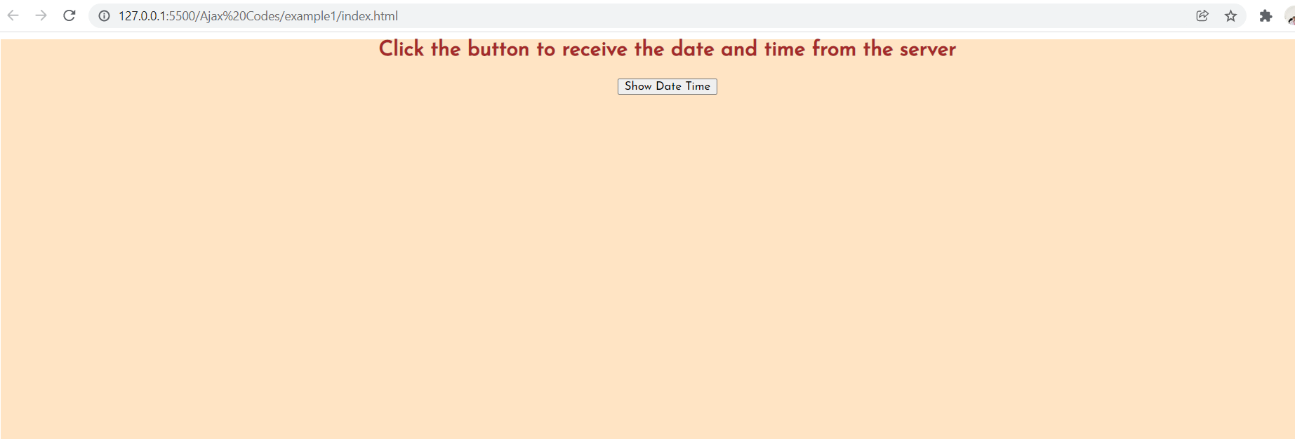
Desired output

Slide 32
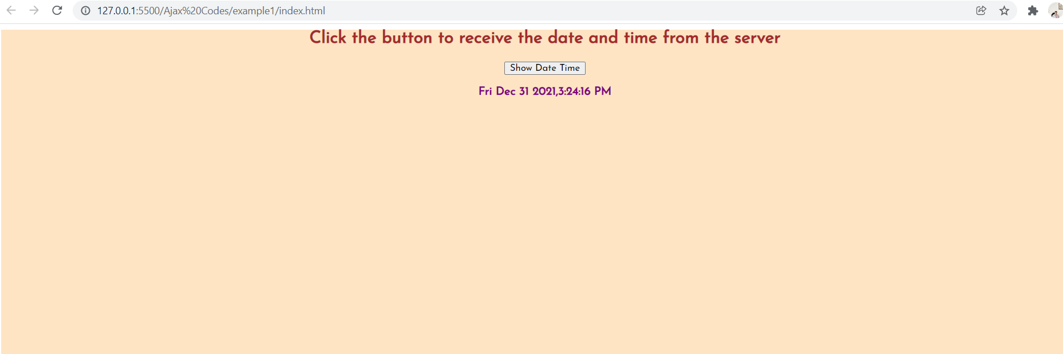
Desired output

Slide 33
aSSIGNMENT
Write an AJAX based application to do the
following:
As soon as the page loads , pull all the timezones available from the api end point: http://worldtimeapi.org/api/timezone
Now when the user selects a timezone and clicks the button thenr display its current date and time using the api end point: http://worldtimeapi.org/api/timezone/<timezonename>

Slide 34
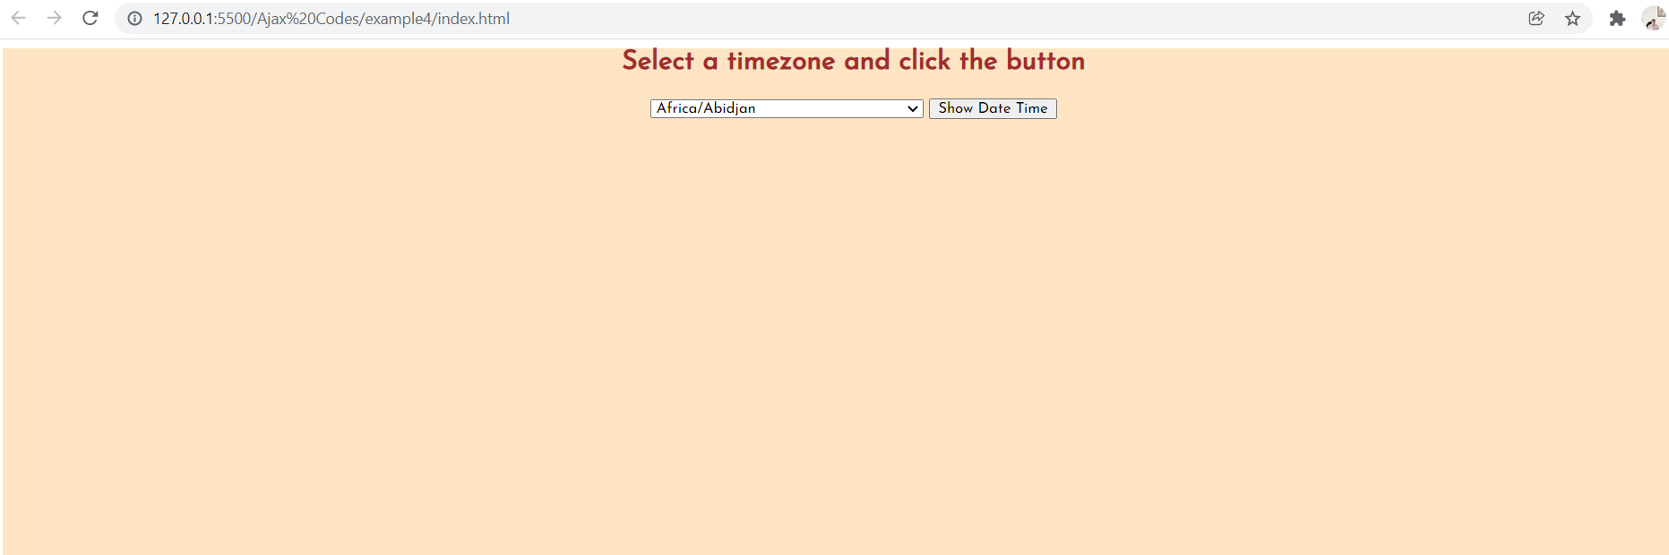
Desired output

Slide 35
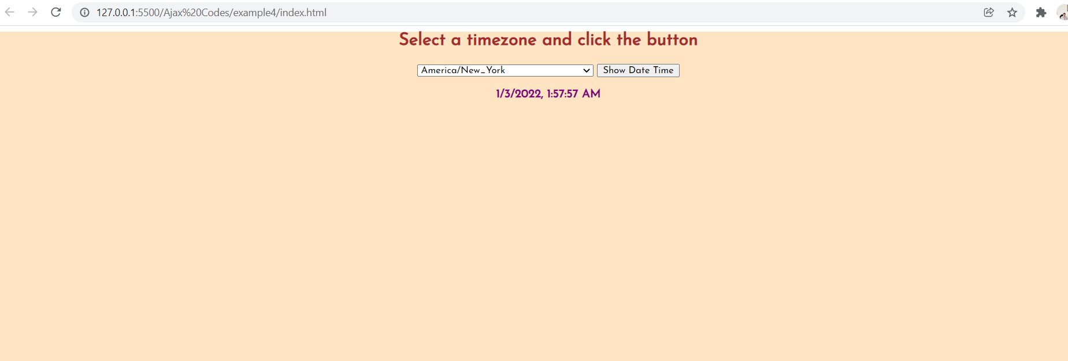
Desired output

Slide 36
PROJECT
Write an AJAX based application to do the following:
Provide a button to the user and when the user clicks it pull all the country names available from the api end point: https://restcountries.com/v2/all
Now as soon as the user selects a country display three details about that country:
Country Flag
Region
Population
Language
Currency

Slide 37

Desired output

Slide 38

Desired output

Slide 39
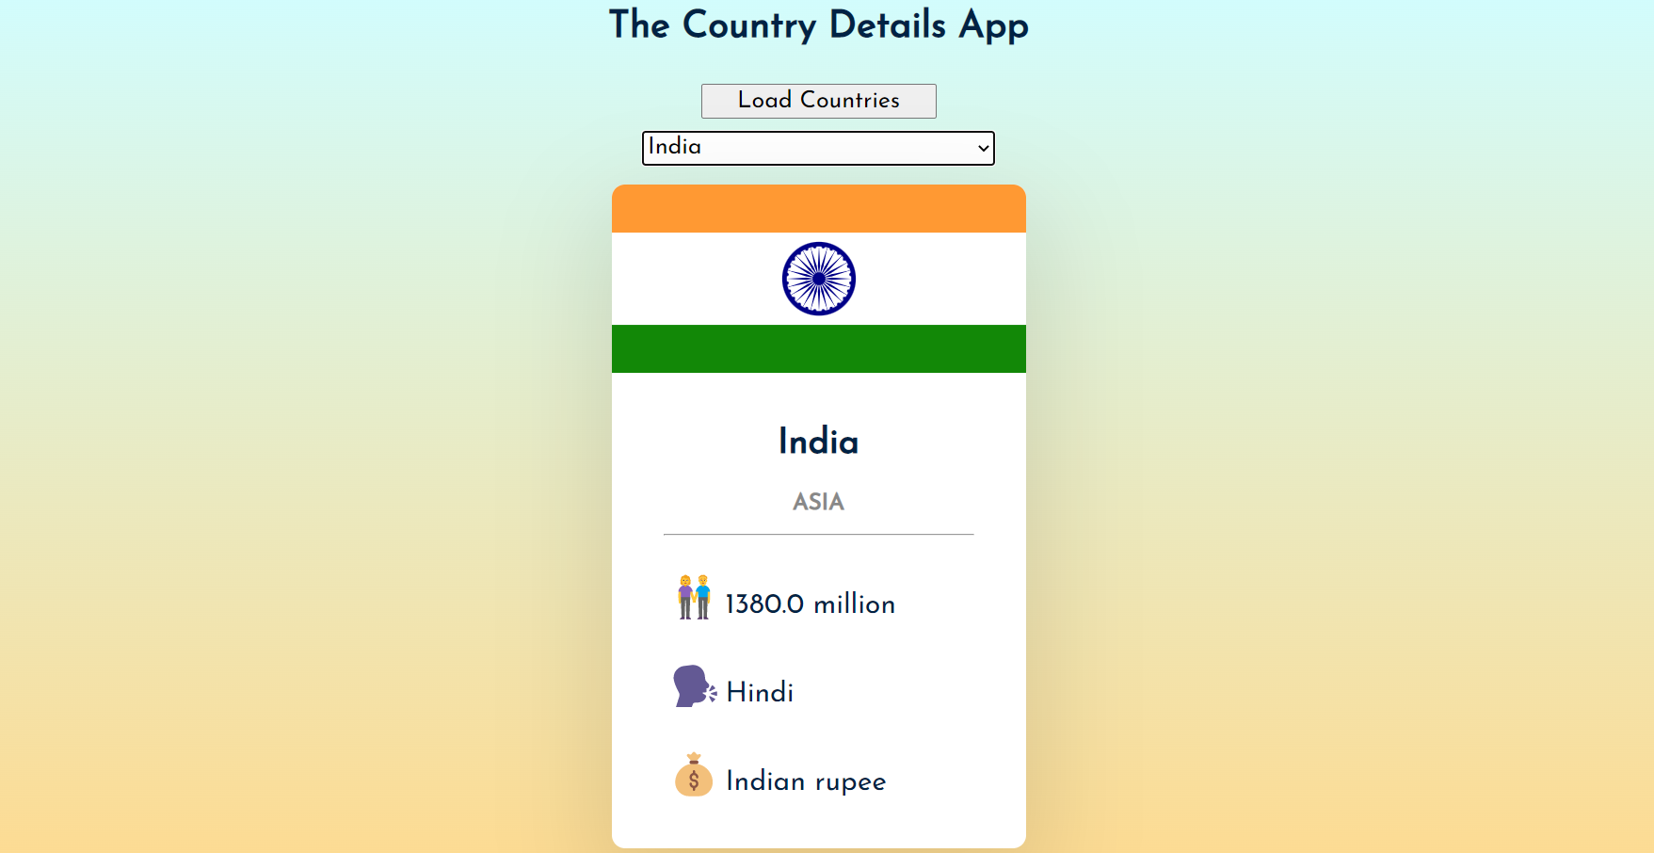
Desired output

Slide 40
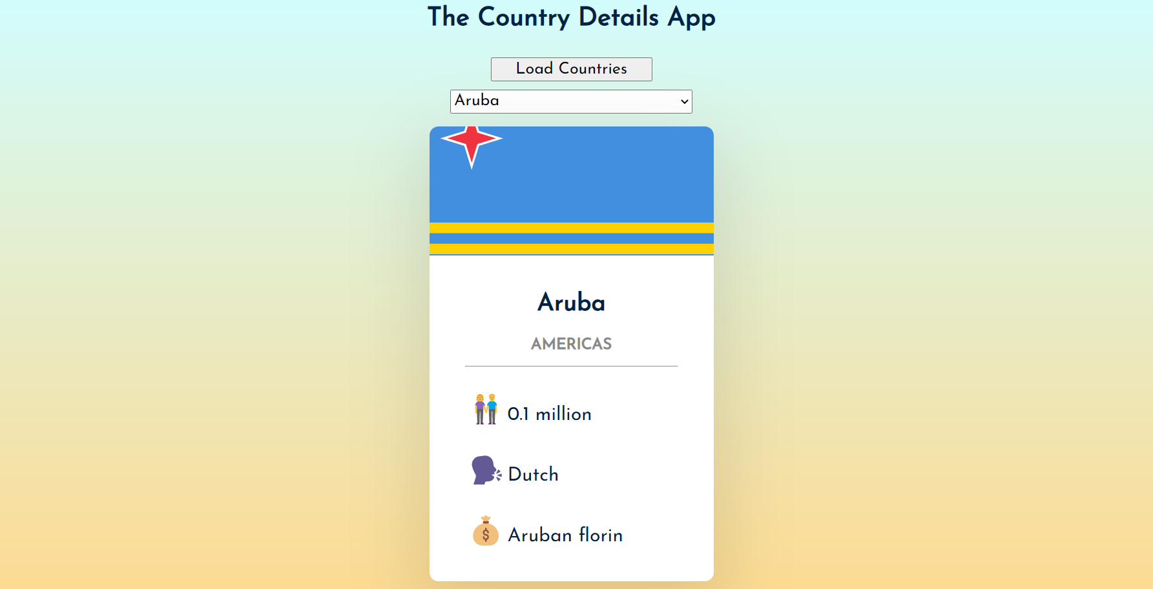
Desired output

Slide 41

Thanks!
Any questions?
You can find me at:
Email id: info@scalive.in
Contact no. : +917314853128

